Slide 1


RPA Essential Training Nanyang Polytechnic School of Information Technology

Slide 2

Create in UiPath
Create dataTable

Slide 3
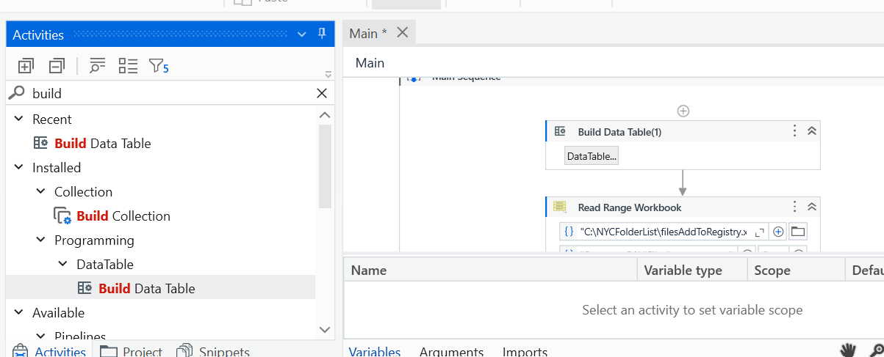
Create in UiPath
Select this function to create a DataTable for data storage
Double click on this box in here and you will see another pop up

Slide 4
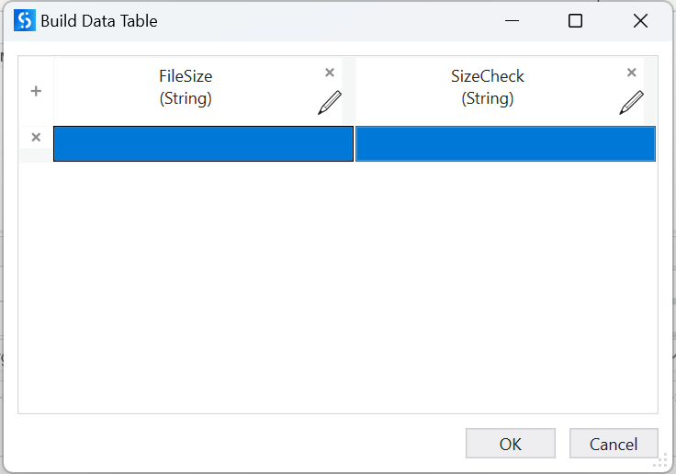
Create in UiPath
Change the name of the datatable to the name FileSize and Sizecheck with the edit pen icon

Slide 5
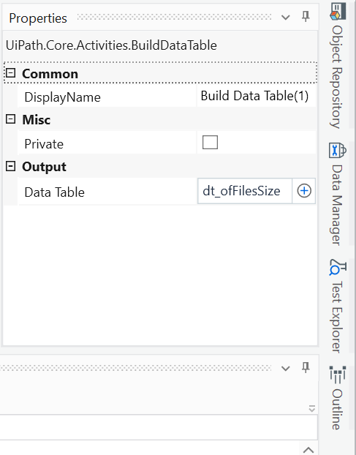
Create in UiPath
On the Right hand properties panel. Click on the dataTable and type control + k in the keyboard. This will allow you to use a new variable and immediately declare the variable automatically.

Slide 6
Read in UiPath
Reading data
Assigning Values in variable

Slide 7
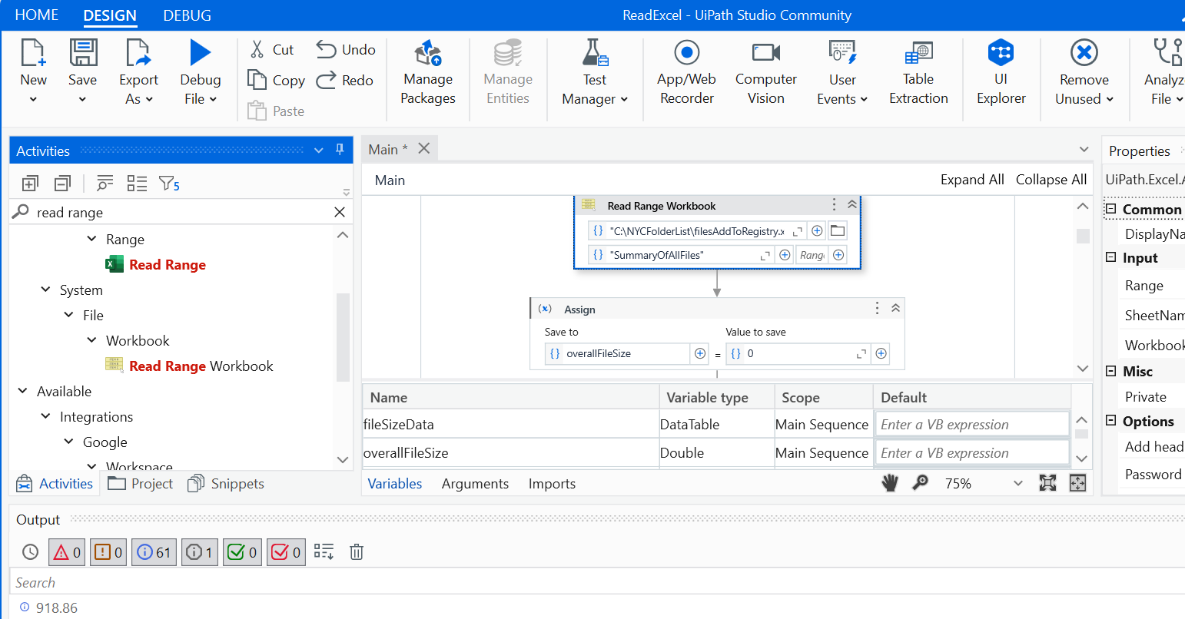
Read in UiPath
On the left hand panel. Click on the read Range workbook

Slide 8
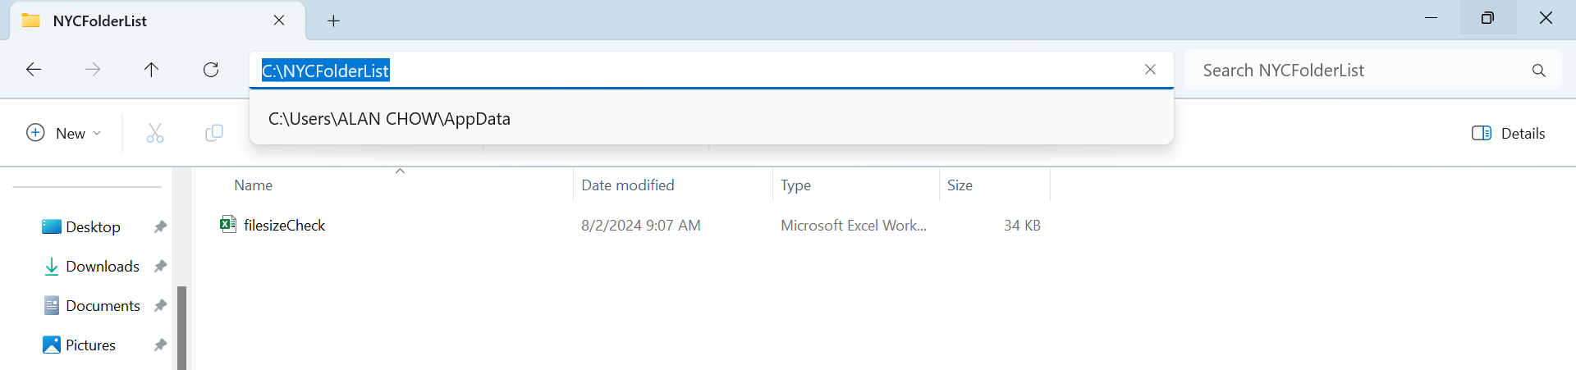
Read in UiPath
Create a folder call NYCFolderList in your C drive as shown and put the excel below into the c:\NYCfolderList. Then load the excel file into this folder and name it as filesize.

Slide 9
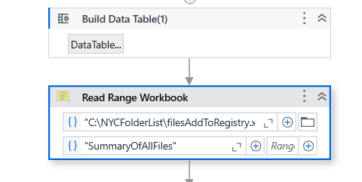
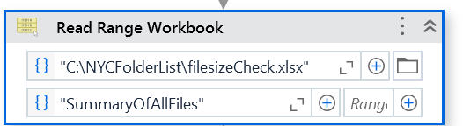
Read in UiPath
Type "C:\NYCFolderList\filesizeCheck.xlsx“ into your read file source
Type "SummaryOfAllFiles“ into this input box for uipath to know which excel tap we are getting the data from. The Range shall remain empty for uipath to read all data in summary tab

Slide 10
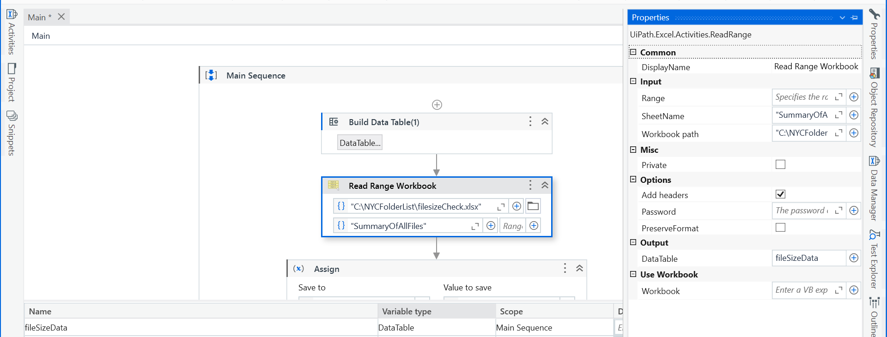
Read in UiPath
On the right hand panel, properties. Click on the dataTable, and press keystroke “control” + “k”, then type in fileSizeData
Check if it is a dataTable, if not select dataTable

Slide 11
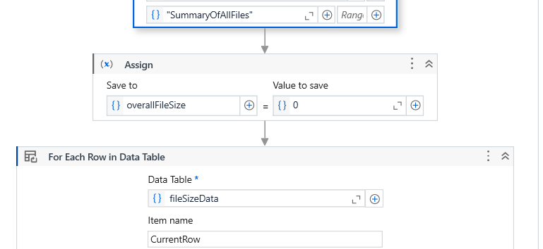
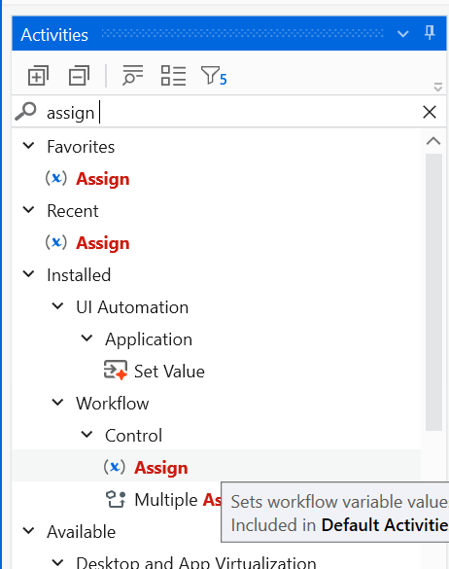
Read in UiPath
1) Before we can update and data, we need to assign variables and use them to do calculation. For instance, a variable to keep track of the total file size
2) Select the assign task and put below the read range workbook.
3) Type control + k in this input box and put a variable overallFileSize and set to 0

Slide 12
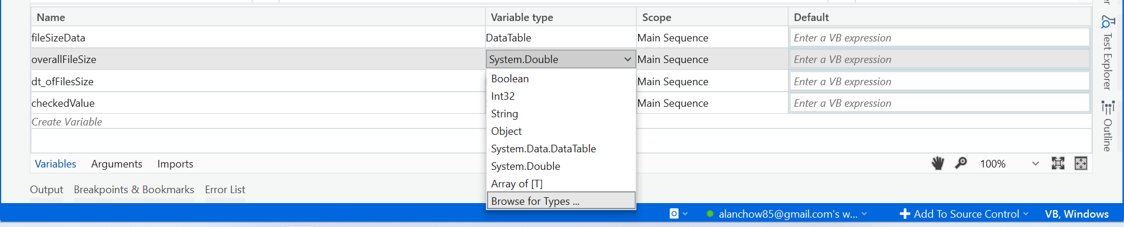
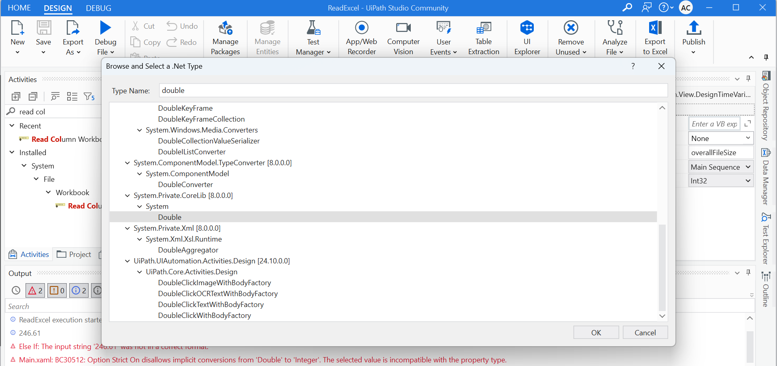
4)Go to the variable panel and change the overallFileSize to double by selecting browse for types as shown below
5)Search for double and select it as shown below

Slide 13
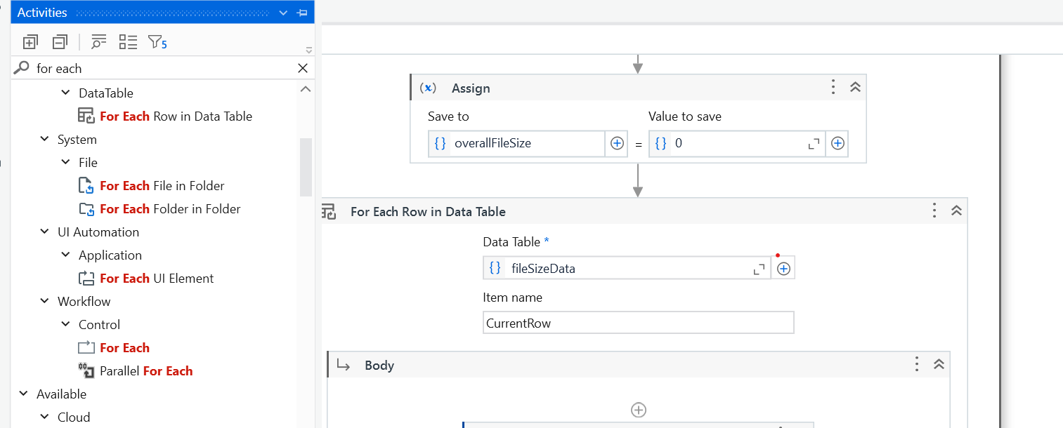
6)Search for the activity for each row in Data Table and put below the assign activity
7)Select fileSizeData as the dataTable

Slide 14
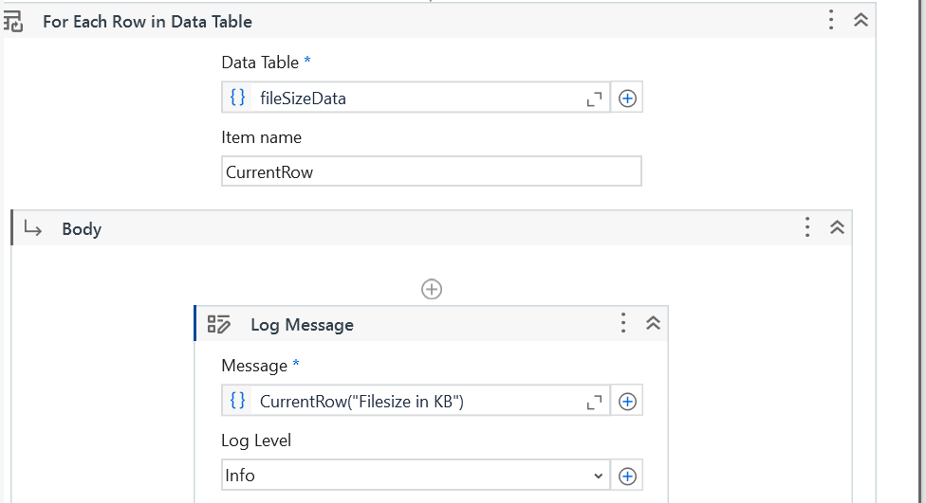
In the body of the for each loop, add a log Message activity and set the message as CurrentRow("Filesize in KB")
Put it as a info log.

Slide 15
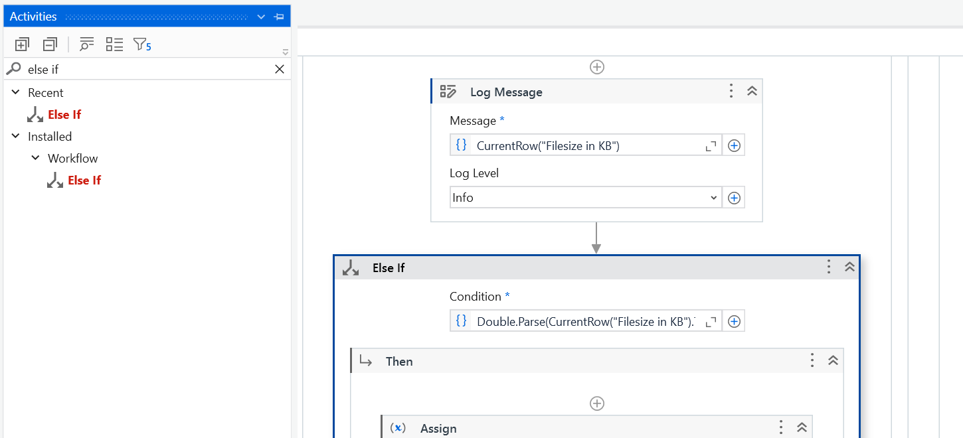
Update in UiPath
Below the log Message, put the else if activity. Put the condition check for any file more than 200kb.
Double.Parse(CurrentRow("Filesize in KB").ToString) > 200

Slide 16
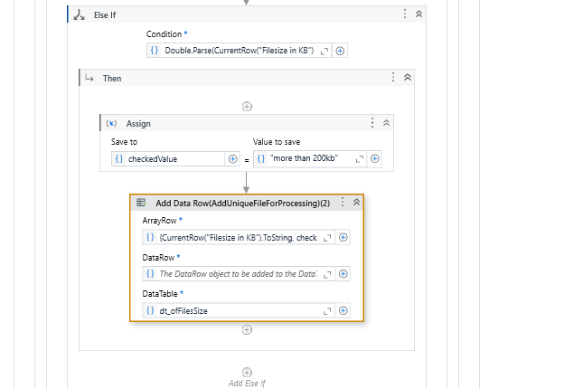
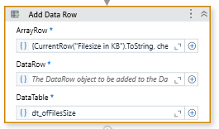
Update in UiPath
Use the assign value activity to put the checkedValue as "more than 200kb"
Use the “add Data Row” activity and add the array below:
{CurrentRow("Filesize in KB").ToString, checkedValue}
Select the dataTable we create earlier
dt_ofFilesSize

Slide 17
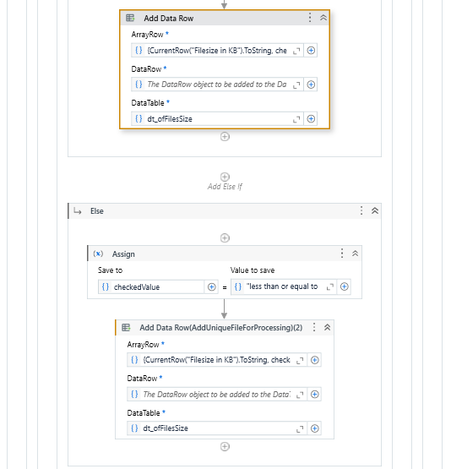
Update in UiPath
In the Else component, use the assign activity like the earlier part but this time, put the checkedValue as
"less than or equal to 200kb"
Like the earlier part,
Use the “add Data Row” activity and add the array below:
{CurrentRow("Filesize in KB").ToString, checkedValue}
Select the dataTable we create earlier
dt_ofFilesSize

Slide 18
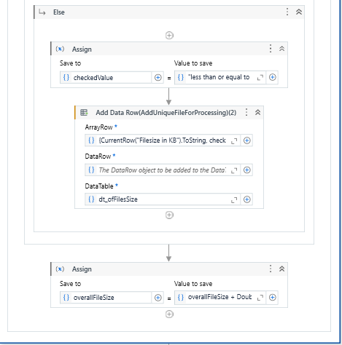
Update in UiPath
Assign value of overallFileSize to
overallFileSize + Double.Parse(CurrentRow("Filesize in KB").ToString)

Slide 19
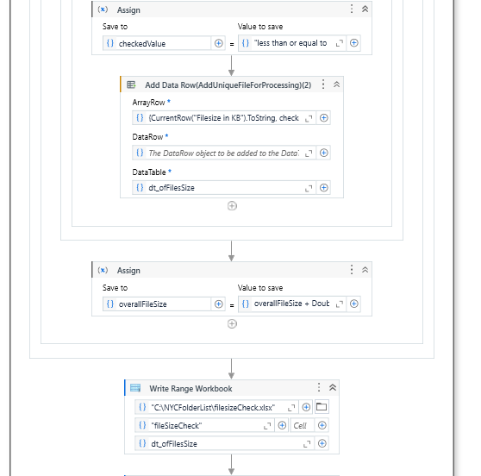
Update in UiPath
Use the “Write Range workbook” activity and add the array below:
and select the location of the filesizeCheck.xlsx excel. In this example, it is in the location "C:\NYCFolderList\filesizeCheck.xlsx"
Include the sheet name of excel as "fileSizeCheck"
Set datatable as dt_ofFilesSize

Slide 20
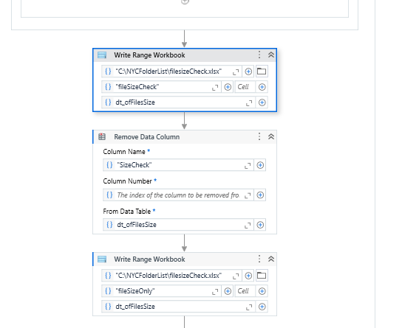
Delete in UiPath
Use the “Remove Data Column” activity and set column Name as:
“SizeCheck"
Set datatable as dt_ofFilesSize

Slide 21
Delete in UiPath
Use the “Write Range workbook” activity and add the array below:
and select the location of the filesizeCheck.xlsx excel. In this example, it is in the location "C:\NYCFolderList\filesizeCheck.xlsx"
Include the sheet name of excel as "fileSizeCheck"
Set datatable as dt_ofFilesSize

Slide 22
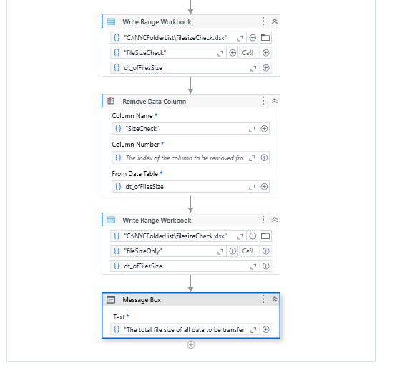
Delete in UiPath
Add a message box and put the message as
"The total file size of all data to be transferred is: " + overallFileSize.ToString + "kb"
Run your bot and see the output in the excel in C:\NYCFolderList as check the new datatables in fileSizeCheck and fileSizeOnly tabs. ☺

